Slide 1
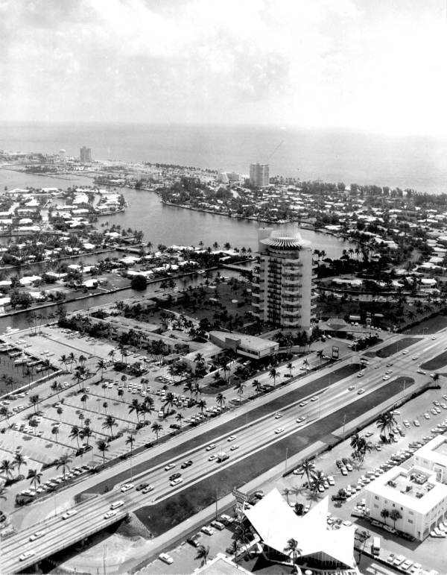
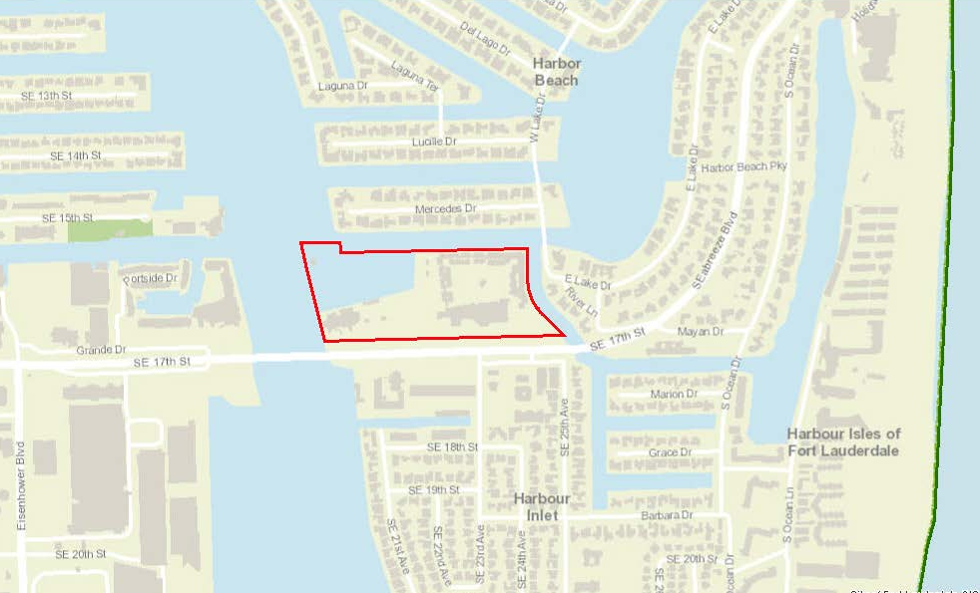
Pier 66 1975
PIER 66 MOTOR HOTEL ADDITION AKA PIER 66 HOTEL TOWER

Slide 2
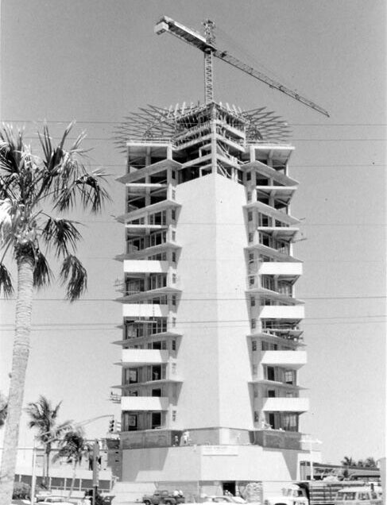
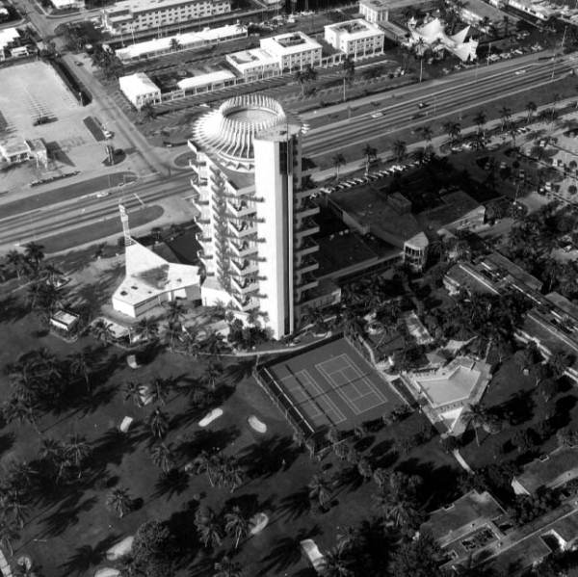
Date of Construction: 1965
Setting: The Pier 66 Hotel and Marina is a 22-acre parcel of land located at 2301 SE 17th Street on the north side of the causeway/17th Street Bridge and adjacent to the Intracoastal Waterway.
Period of Significance:
The period of significance extends from construction of the building in 1965 until its sale in 1985, after the Phillips Petroleum Company sold to three Fort Lauderdale businessmen.
Pier 66, circa 1975.
INTRODUCTION

Slide 3
Founded: The demand for oil during WWI led the Phillips brothers to consolidate their oil holdings and found one of the most influential energy companies in the United States. Incorporated in Bartlesville, Oklahoma by Frank and L.E. Phillips on June 13, 1917.
First Gas Station: First Service Station is opened on November 19, 1927 in Wichita, Kansas.
First Refinery:
In 1927, the Phillips Petroleum Company opened its first refinery in a small town near Borger in the Texas Panhandles known today as Phillips.
Frank Phillips (1873-1950), Founder of the Phillips Petroleum Company. Source: Business Builders in Oil
L.E. (left) and Frank Phillips. Source: Business Builders in Oil
HISTORY: FRANK PHILLIPS AND THE PHILLIPS PETROLEUM COMPANY

Slide 4
The Phillips 66 station, the first ever built. Source: Business Builders in Oil
HISTORY: FRANK PHILLIPS AND THE PHILLIPS PETROLEUM COMPANY

Slide 5
Branded: Continued financial success supported the advancement and refinement of the Phillips Petroleum Product, which yielded a superior product that helped cars run more smoothly and start more easily in cold weather. The Phillips Petroleum tested its new product on U.S. Highway 66 in Oklahoma when the car reached almost 66 miles per hour. This inspired the name Phillips 66.
Phillips 66 logo. Source: Business Builders in Oil
HISTORY: LOGO DEVELOPMENT AND KENNETH S. ADAMS

Slide 6
Company Advancement During the Great Depression and WWII: Kenneth S. (Boots) Adams was promoted to assistant to the President, Frank Phillips in 1932. In 1938, Adams succeeded Frank Phillips as President. The Phillips Petroleum Company advanced during the Depression years and secured the company’s growth and continued success during World War (1938-1945) and thereafter.
Company Advancement Post World War II:
Phillips died in 1950, and Adams succeed him as Chairman and CEO. Under Adams, the capital expansion program was ambitious expanding beyond the Midwest to the South and Atlantic Seaboard.
Kenneth S. Adams. Source: Fort Lauderdale news, Phillips 66 Grows in State: Adams is ‘Florida’ Friends, 1966.
HISTORY: LOGO DEVELOPMENT AND KENNETH S. ADAMS

Slide 7
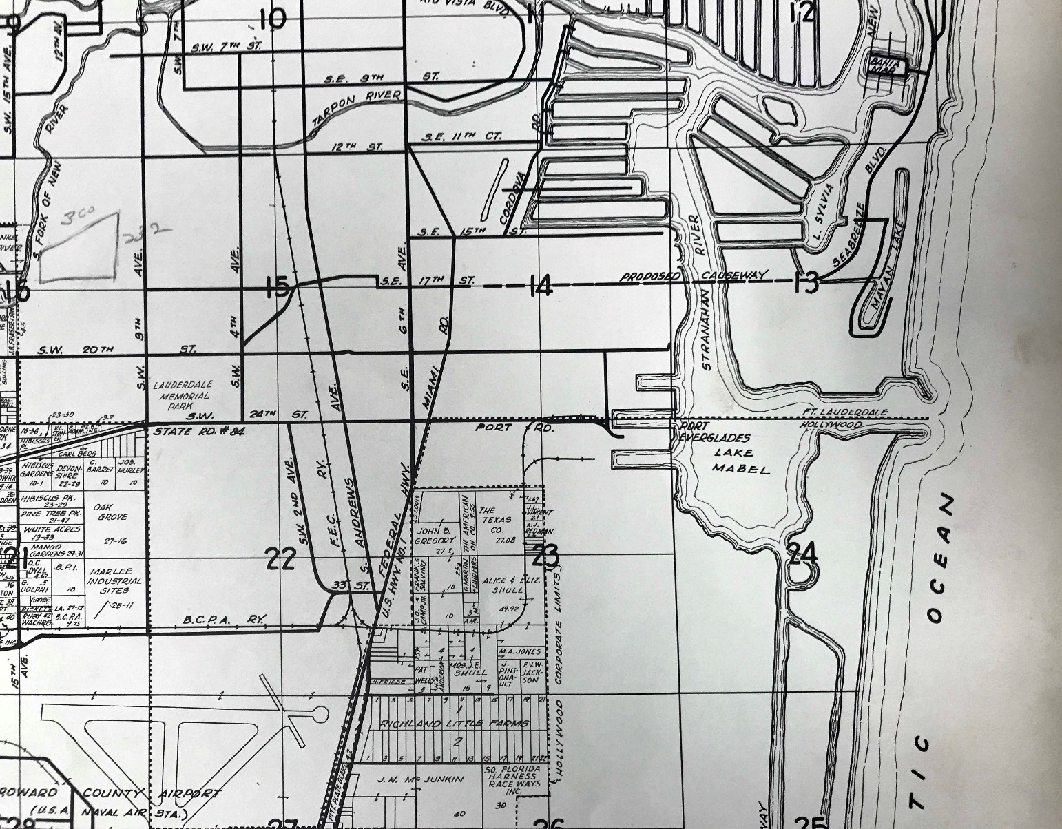
Location, location, location: Adams understood that Fort Lauderdale was an ideal place for the Company’s growth initiatives and announced their intentions for investment and expansion in Fort Lauderdale unveiling plans for the development of a 22-acre property adjacent to the Causeway at SE 17th Street and the Intracoastal Waterway, a 29-acre site at Port Everglades, and institution of a gas station building program. The Company constructed a terminal at Port Everglades that was supplied from the company’s refinery on the Texas gulf coast. The strategic development and proximity of Pier 66, the terminal at the Port, and local gas stations contributed to the success of Phillips Petroleum Company’s expansion in Fort Lauderdale.
PIER 66 MARINA
SITE
PORT EVERGLADES
Map Date: 1947, Land Atlas, Broward County , FL
HISTORY: ADAMS AND FORT LAUDERDALE

Slide 8
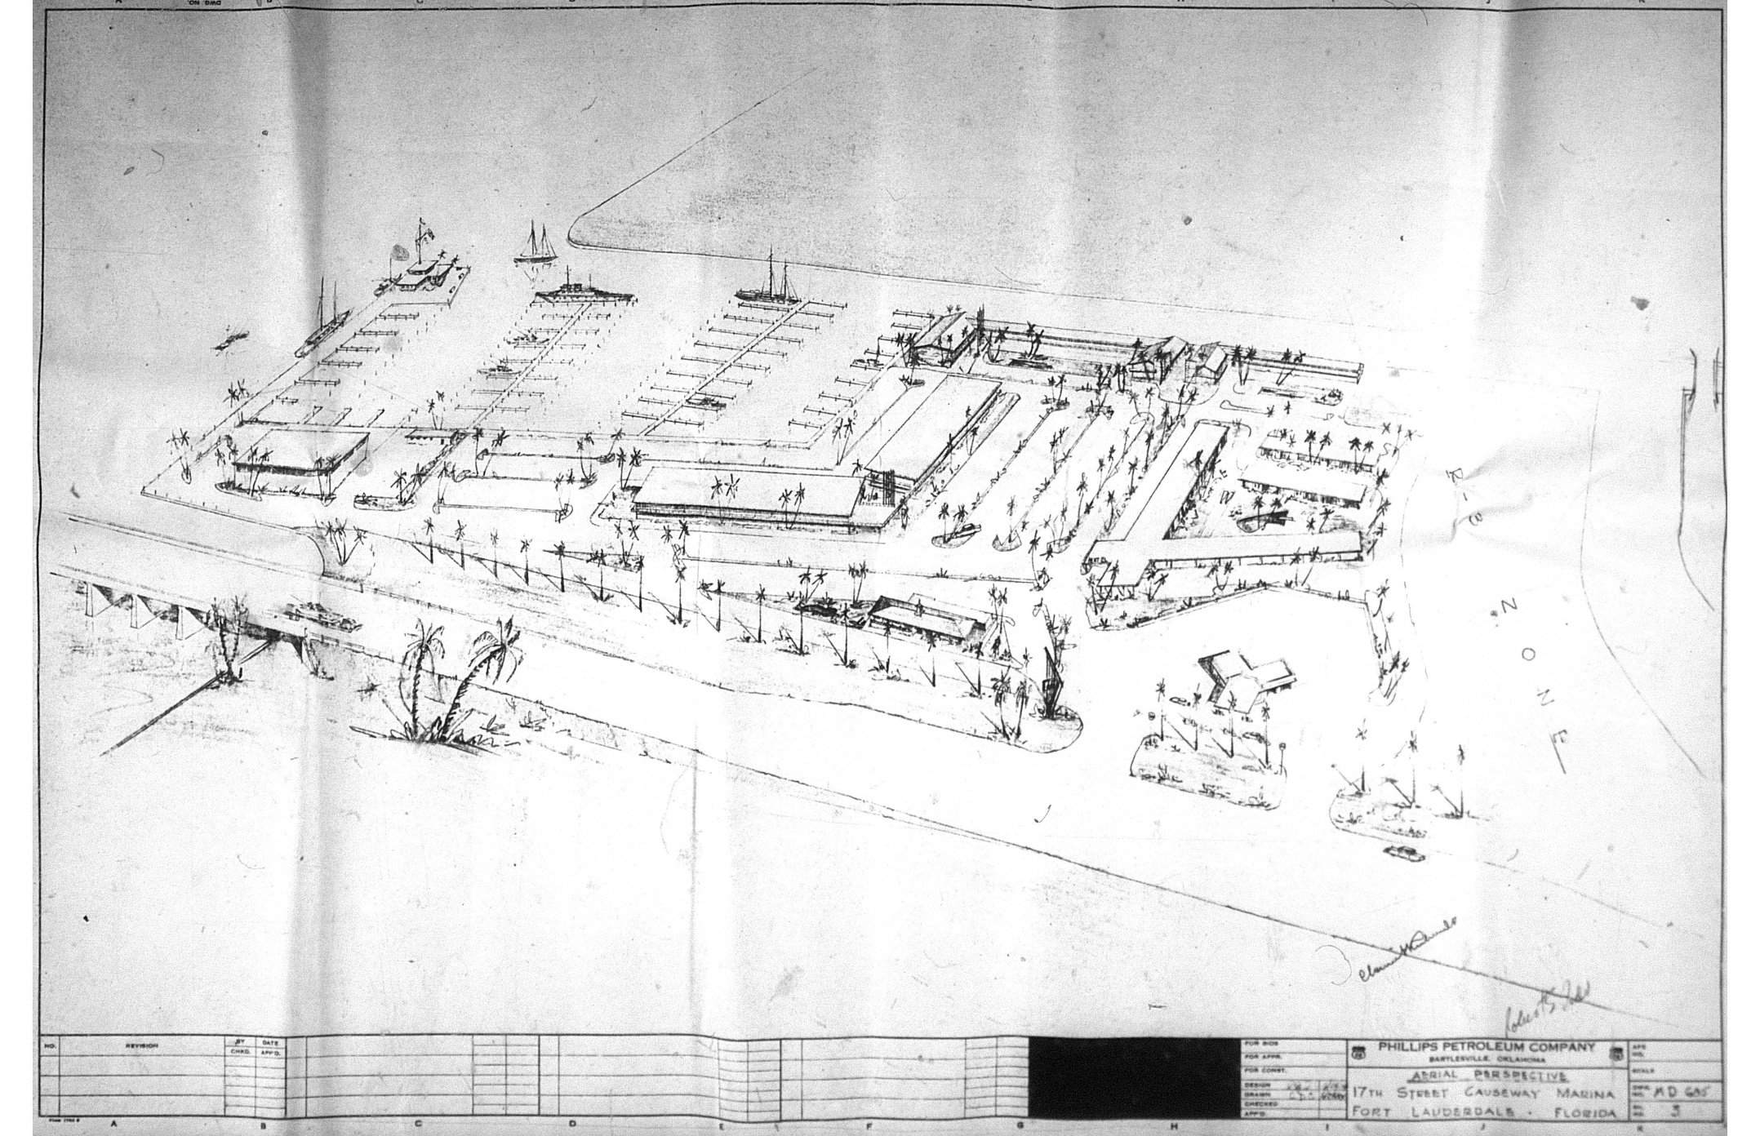
ORIGINAL PIER 66 MARINA
MASTER PLAN CONCEPTS
Vertical Phillips 66 Signage and Branding
Marine Fueling Dock
MARINE SERVICE STATION
FUTURE MOTOR HOTEL
FACILITIES
AUTOMOBILE SERVICE
STATION
MARINE
SUPPORT FACILITIES
ARCHITECT CLARENCE
REINHARDT SIGNATURE
Vertical Phillips 66 Signage and Branding
Automobile Service Station
PARKING FACILITIES
ARCHITECT ROBERT S. TODD
SIGNATURE
Phillips Petroleum Drawings Pre-1956
PIER 66 MARINA MASTER PLAN 1955-56
Notes:
Established in 1955 by the Phillips Petroleum Company, Pier 66 began as a yacht marina with a fueling dock and boat service facility as well as an automobile service station, both completed in 1956. At the onset of the project, the Company announced their intentions to construct a motel, and restaurant and yacht club building. The Pier 66 Restaurant and Lounge was completed in 1957. Shortly after, plans were underway for the 102-room Motor Hotel (1958-59) and 9-hole, par-3 golf course, swimming pool, restaurant, and other amenities.

Slide 9
Pier 66 Development: The success, rapid development, and reputation of Pier 66, Marina, Restaurant and Lounge, and Motor Hotel necessitated more rooms and meeting facilities. In 1963, the Phillips Petroleum Company announced the development of the Hotel Tower, a unique 19-story concept that added 160 rooms to the existing 102-rooms.
Architects: The architectural design of the Tower was the result of collaborative work of the Phillips Petroleum Company’s in-house architects Richard F. Humble, AIA, who was the lead design and planning director for the company that led the Marina project, and Clarence Reinhardt, AIA. As a licensed Florida architect, Reinhardt signed and sealed all the working drawings submitted to the local authorities.
Pier 66 in construction, circa 1965. Source: Fort Lauderdale Historical Society
PIER 66 DEVELOPMENT

Slide 10
Design Influence: The Phillips Petroleum Company, understood the importance of design and creating an instantly recognizable brand that customers new and trusted.
The Company tested a new V-shaped canopy at a new service station in 1956 in Fort Lauderdale at Pier 66. The design of the new stations included rock-faced large slanted windows known as Rock Frames, a change in color scheme and resulting in the painting of red, diamond like symbols on the stations and the introduction of the triangular pointed canopies
By the 1950s, architect Clarence Reinhardt, was producing plans and specifications for most of the Phillips Petroleum Company buildings including the canopy at the Pier 66 Marina. Reinhardt was inspired by the early Los Angeles-area drive-ins which influenced the form of the gas station canopies. The stations were designed to be “inviting and identifiable”. In addition to the design and color scheme, the Company also understood the importance of lighting and lit the underside of the canopies.
DESIGN INFLUENCE

Slide 11
Design Influence: The design influence inspired by the architectural trend that started in California in the 1940s is referred to as Googie. The Googie style of architecture is “characterized by bold, angular forms and an intensive use of steel, glass and neon inspired by The Space Age, science fiction, and car culture”.
DESIGN INFLUENCE

Slide 12
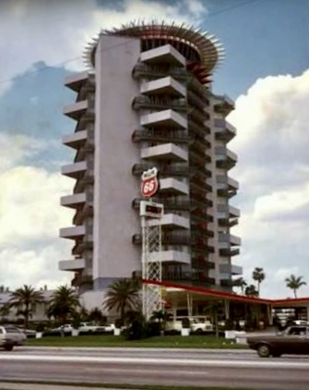
Design Influence: The discussion of the gas station canopy design influence is important because the iconic triangular canopy shape became a symbol of the Phillips Petroleum Company like the Phillips 66 logo.
The triangle shape is employed in the Tower in several instances, but the most significant architectural feature is the crown element of the top floor featuring the trihedrons. A trihedron is a geometric shape composed of three planes, constructed of steel tubes and finished with porcelain enamel.
Roadside gas station and Tower. Source: Vanishing Points: Phillips’ Postwar ‘New Look’ Service Stations, 2019.
DESIGN INFLUENCE

Slide 13
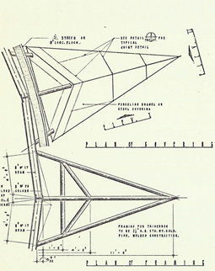
Design Influence: The other triangular architectural elements employed at the Tower are the outriggers, vertical fins, and cantilevered balconies. Like the canopies, the underside of the trihedrons were lit to draw attention to the shape and the top of the building which rotated affording 360-degree panoramic views of Fort Lauderdale and the Pier 66 Marina. Furthermore, the use of floor-to-ceiling slanted windows was also an important design feature of the gas stations in late 1950s and 1960s that are also featured in the crown.
Trihedron Detail. Source: Phillips Petroleum Motor Hotel Addition Drawings, 1964
DESIGN INFLUENCE

Slide 14
c. Its identification with a person or persons who significantly contributed to the development of city, state, or nation.
The Pier 66 Hotel Tower is significant for its association with the Phillips Petroleum Company and three of its employees: Frank Phillips, Founder, President, Chairman; Kenneth S. Adams, the company’s second President; and Richard F. Humble, lead architect of Phillips Petroleum Design and Development Department and designer of the Pier 66 Hotel Tower. Adams succeeded Franks Phillips as President in 1938 and as Chairmen and CEO in 1950. Under Adams leadership, the Phillips Petroleum Company had an aggressive capital expenditures program which expanded the company’s reach beyond the Midwest to the South and the Eastern Seaboard.
Adams strategic decision to construct a terminal at Port Everglades, develop Pier 66 Marina and Hotel and institute a gas station building program in Fort Lauderdale contributed to the growth and development of the area. The availability of more gas stations in the area afforded motorist with the opportunity for convenient and leisurely travel. As more tourists flocked to the area, there was a demand for recreational and lodging accommodations. The development of the Pier 66 Marina and Hotel created a tourist designation, local employment opportunities and stimulated the local economy.
APPLICATION FOR CRITERIA FOR DESIGNATION

Slide 15
e. Its value as a building recognized for the quality of its architecture, and sufficient elements showing its architectural significance.
The Pier 66 Hotel Tower is locally significant as a distinct example of Mid-Twentieth-Century Modern design in Fort Lauderdale, FL representative of the Phillips Petroleum Company’s Design and Development and Marketing Departments embrace of the modern design ideologies influenced by trending architectural styles such as Googie and the availability of new technologies and building materials readily available after World War II. The design of the Tower’s crown, specifically the trihedrons, is influenced by the elements of the successful gas station design of the early 1950s and 1960s that featured lighted V-shaped canopies, slanted floor-to-ceiling windows, rotating Phillips 66 logo mounted high above the canopy, and even the color scheme, which is no longer visible on the crown. However, the original color remains below various painting campaigns. These elements define the Pier 66 Hotel Tower. The Tower serves a monument to the Phillips Petroleum Company and the success of their gas station expansion and rebranding program of the early 1950s and 1960s, specifically in the Fort Lauderdale area and decision to unveil the canopy protype at Pier 66. The design of the Pier 66 Hotel Tower employs many Mid-Twentieth-Century Modern buildings materials like architectural precast concrete, prestressed concrete units, porcelain enamel steel, and aluminum.
APPLICATION FOR CRITERIA FOR DESIGNATION

Slide 16
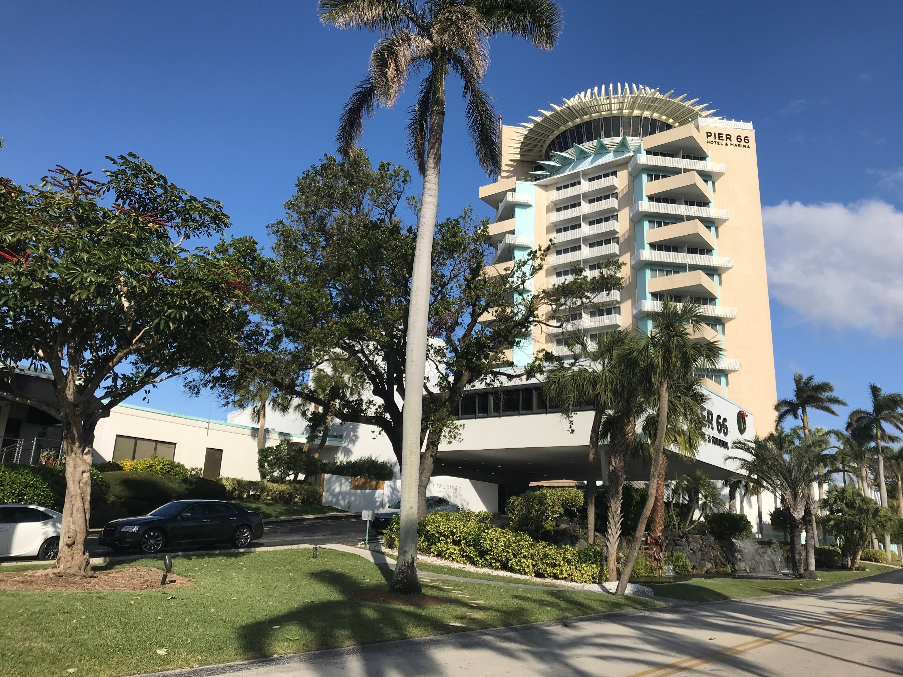
APPLICATION FOR CRITERIA FOR DESIGNATION

